Slide 1
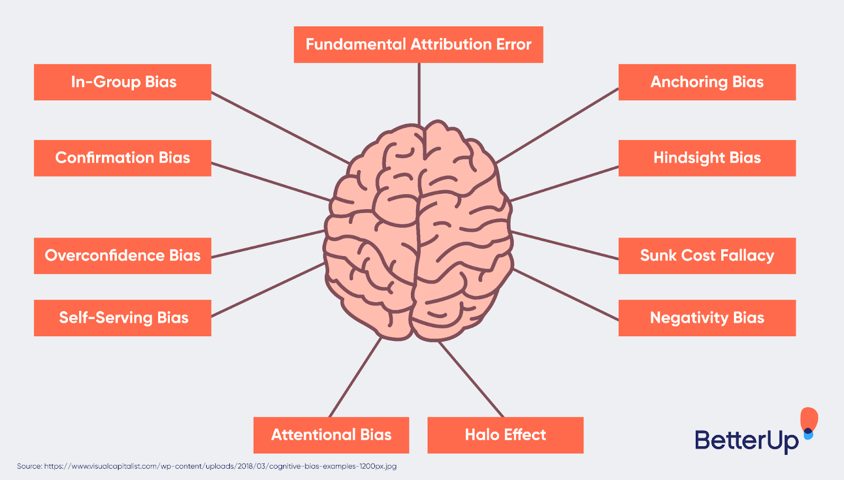
Biases in Software Development: A Field Study
A comprehensive analysis of how biases influence developer actions.
By Dhananjay Sapawat and Harshit Mawandia

Slide 2
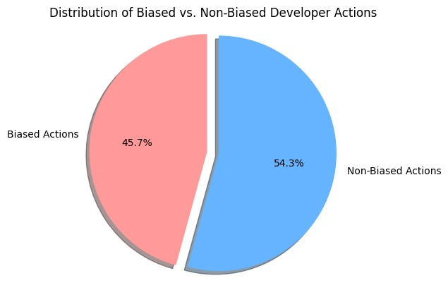
Introduction
A cognitive bias is a systematic pattern of deviation from norm or rationality in judgment.
Individuals create their own "subjective reality" from their perception of the input.
Developers are not immune to biases due to cognitive limitations and past experiences.
for example, availability bias may prompt developers to choose solutions based on examples they readily remember
Although these cognitive biases often result in desired solutions, they may also cause significant negative consequences.

Slide 3



Background
Cognitive biases were first introduced in 1974 by researchers Tversky and Kahneman
studies have found that confirmation bias leads to higher defect rates and more postrelease defects when testing
availability and representativeness biases lead to developers misrepresenting code features;

Slide 4
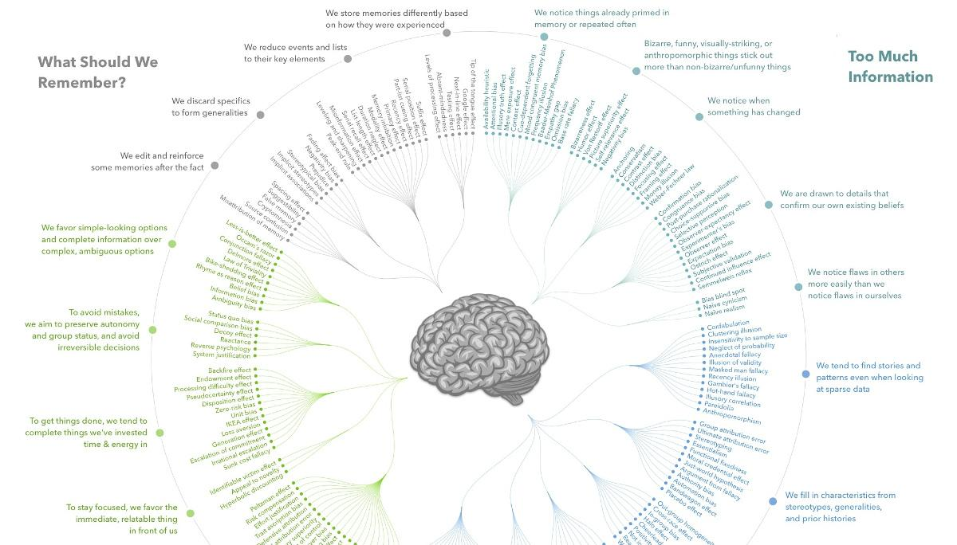

Slide 5

Reversal Actions
not all cognitive biases necessarily result in a negative outcome.
Reversal actions are the actions that developers need to undo, redo, or discard at a later time.

Slide 6
Methodology
Field Study: Observed real-world developer actions, capturing a total of 2084 distinct actions.
Bias Classification: From the observed actions, 953 were identified as containing at least one form of cognitive bias.
Reversal Actions: Defined actions that developers later had to undo, redo, or discard. These served as indicators of negative outcomes from biases.
Time Analysis: Analyzed the time developers spent on each action, especially on reversing actions, to measure the actual cost of biases.
Interviews: Interviewed 16 developers to understand perceived bias frequencies and gather practices to counteract them.

Slide 7
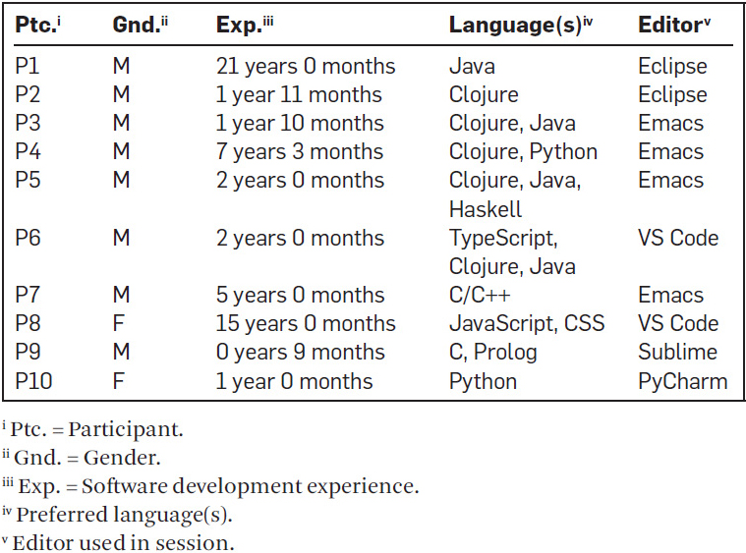
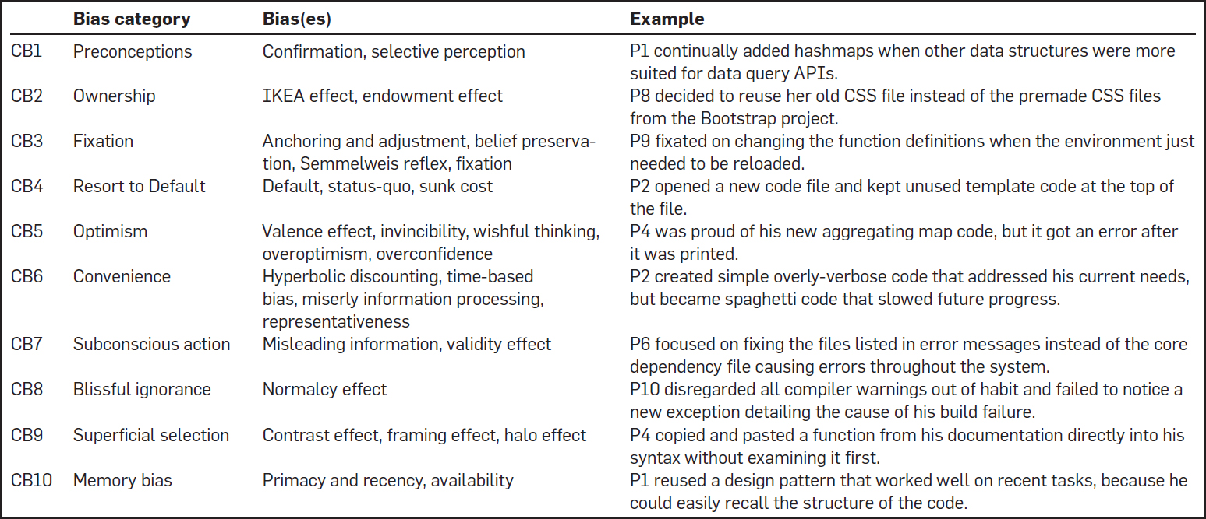

Slide 8
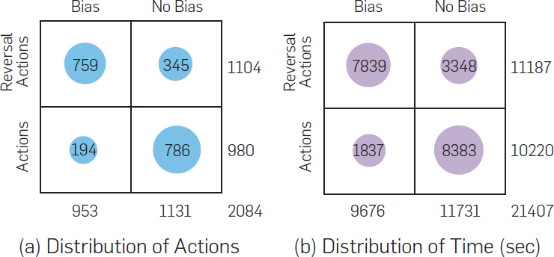
There were 953 actions with biases, and 1131 without. Similarly, there were 1104 reversal actions and 980 non-reversal actions. Reversal actions were more likely to occur with a bias—68.75% (759/1104 cases), and biased actions were more likely to be reversed—79.64% (759/953 cases).
In total, developers spent 34.51% (7839/21407) of their time reversing–biased actions. When focusing only on the time spent in reversal actions, 70.07% (7839/11187) of these involved biases. Therefore, biased actions lead to significant negative outcomes as participants lost approximately 25% of their entire working time

Slide 9
Consequences of Biases
Inadequate Exploration
Key aspect of development is exploring multiple solutions.
Biases can limit this exploration, leading to suboptimal choices.
Example: Settling for a manual method over learning a new interface.
Reduced Sense-Making
Engaging with information to create mental models is essential.
Biases can distort this, leading to incorrect assumptions/actions.
Example: Following error messages blindly without understanding the cause.
Context Loss
Developers must maintain a mental context of tasks and goals.
Biases can disrupt this, causing backtracking and confusion.
Example: Getting sidetracked and forgetting the main objective.
Misplaced Attention
Attention guides what developers perceive as relevant.
Biases can divert this attention to less critical issues.
Example: Fixating on syntax while missing larger environment errors.

Slide 10
Most perceived biases
Memory Bias (CB10)
Developers often misremember or overlook details.
Can lead to assumptions based on outdated or incomplete information.
Convenience Bias (CB6)
Choosing the easiest path, even if suboptimal.
Often a root cause for technical debt.
Example: Overwriting existing code because it's easier.
Preconception Bias (CB1)
Making decisions based on pre-existing beliefs.
Can result in overlooking better or more suitable solutions.

Slide 11
Avoiding Biases
Stepping back: Taking a break from one's own development pattern can help developers become aware of beneficial practices (such as clean code), which can avoid biases such as Preconception (CB1) and Memory (CB10).
For example"…documentation days are where we say, 'Today, we're not going to be writing code. We're going to focus on checking the documentation, updating documentation…' You might run into some of the new methods…and then you are more bound to use them next time.
Processes: Good software engineering practices such as designing and testing early and frequently, agile software development, etc. can help avoid biases in all categories to some extent. Developers can avoid biases such as Ownership (CB2) and Resort to Default (CB4) through coding standards and the use of standard libraries. This also helps developers to locate appropriate code to reuse.

Slide 12
Key Insights from the Study
Widespread Bias: Nearly 46% of developer actions show presence of bias.
Reversal Actions: Biased decisions often lead to reversals, consuming significant time.
Multiple Consequences: Biases impact exploration, sense-making, context retention, and attention allocation.
Perception vs Reality: Some biases, like Memory bias, were perceived more frequently than observed.
Mitigation Strategies: Practices like Code Reviews and Collaboration can help address these biases.

Slide 13
Thank you!
Feel free to ask any questions

